Slide 1
Column Charts
Sarah DesMarais, Kelsey Pereira and Courtney Silva

Slide 2
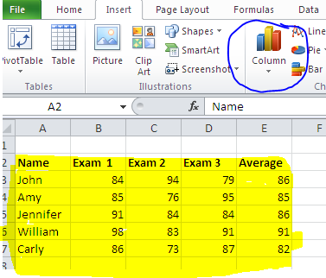
To Create Your Column Chart:
Highlight the cells containing the data you want.
Choose the chart type from the column drop-down menu.
Your data will automatically be converted into the chart type you have selected.

Slide 3
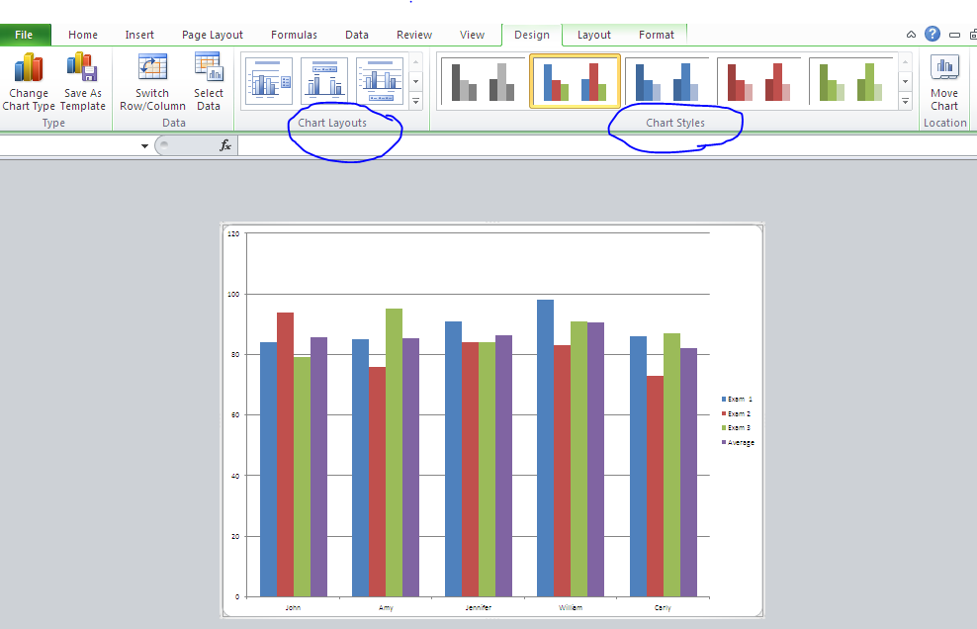
Modifying Your Column Chart
You can :
Move your chart by clicking and dragging it to the desired position or move your chart to a new sheet by hitting the Move Chart button and then selecting New Sheet.
Apply a different style to the chart by selecting a style from the Chart Styles section.
Modify the layout by selecting a layout in the Chart Layout section.

Slide 4
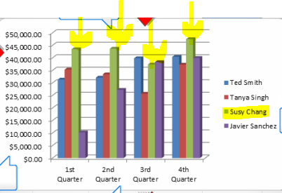
What is the purpose of column charts?
Column charts are used to compare data in an organized and visually attractive way.
Each set of data is color-coded, so you can distinguish one from the other while comparing them, and the height of the columns are compatible with the data; both of which make displaying the data easier to create and understand.

